Slide 1
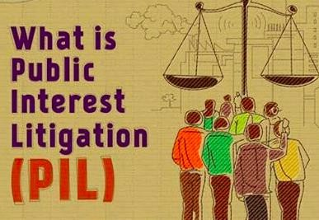
NAWADA VIDHI MAHAVIDYALAYA
Dr. Madhvi Rani
Assistant Professor
Nawada Vidhi Mahavidyalaya, Nawada Bihar

Slide 2
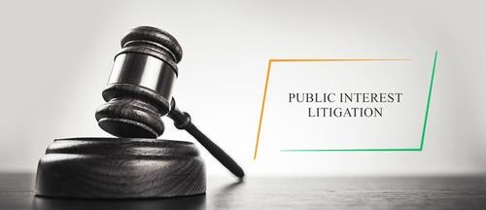

Slide 3
PUBLIC INTEREST LITIGATION
SOCIAL ACTION LITIGATION
The expression Public Interest Litigation(PIL) has been borrowed from American Jurisprudence, Where it was designed to provide legal representation to previously unrepresented groups like the poor, the Rational Minorities, Unorganized humans, Citizens who were passionate about the Environmental issues, etc.

Slide 4
PIL means - Litigation filed in a court of law for the protection of public interest such as
Pollution
Terrorism
Road safety
Constructional hazardous, etc.
Any mater was the interest of the public at large is affected can be redressed by filing PIL in a court of law.
PIL is not defined in any statue or in any act.
It has been interpreted by judges to consider the intent of the public at large.
PIL is the power given to the public by courts through Judicial Activism.

Slide 5
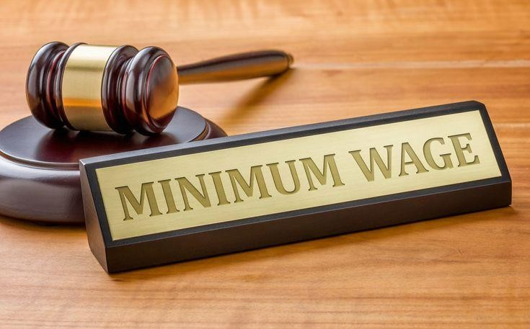
However, the person filing the petition must prove to the satisfaction to the court that the petition is being filed for public interest and not just as previous litigation by a busy board.
The court can itself take cognizance of the matter and proceed Suo moto of cases can commence on the petition of any public-spirited individual.
Some of the matters which are entertained under PIL are:
Bonded Labours Matters
Neglected Children
Non Payment of Minimum Wages to Workers
Exploitation of Workers
Atrocities on Women

Slide 6
Environmental Pollution
Disturbance of Ecological Balance
Food Adulteration
Maintenance of Heritage and Culture.

Slide 7
EVOLUTION OF PUBLIC INTEREST LITIGATION IN INDIA:
The 1st reported case of PIL was Hussainara khatoon v. State Of Bihar 1979. that focused on the inhuman conditions of prisons and under trial prisoners that let to the release of more than 40,000 under trial prisoners.
Right to speedy justice emerged as a basic Fundamental Right (FR) which had been denied to the prisoners.
The same set pattern was adopted in subsequent cases.
A new era of PIL was done by Justice P.N.Bhagawati in the case of
S.P.Gupta v. Union Of India.

Slide 8
In this case, it was held that any member of the public or social action acting bonafide can evoke the writ jurisdiction of the High Court under Article-226 or the Supreme Court under Article- 32 seeking redressal against violation of legal or constitutional rights of the persons who due to Social, Economic, by other disability cannot approach the court.
By this judgment, PIL becomes a potent weapon for the enforcement of the public duties. Where executive action or misleading resulted in public injury and as a result, any citizen of India or any consumer groups or social action groups can approach the apex court of the country seeking legal remedies in all cases where the interest of the general public or a section of the public or a state.
Justice Bhagawati did a lot to ensure the concept of PIL was clearly initiated. He did not insist on the observance of procedural technicalities and even treated ordinary letters from public-minded individuals as writ petitions.

Slide 9
CASE LAWS:
Indian Bank Association in Bombay & others v. Mrs. Deva Kala Constancy Services & others.
In this case, the supreme court held that in an inappropriate case where the petitioner might have moved a court in her private interest and for redressal of the personal grievance the court in furtherance public interest may treat it a necessity to enquires into the state of affairs of the subject of litigation in the interest of Justice.
Thus, a private interest case can also retreat as the public interest.

Slide 10
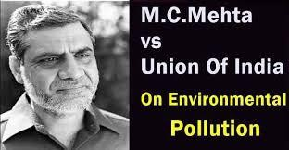
In M.C.Mehata v. Union of India
In a PIL brought against Ganga water pollution, so as to prevent any further pollution of Ganga water. Supreme Court held that petitioner although not a recipient honor, is titled to move the court for enforcement of statutory provisions as he is the person interesting in protecting the lives of the people who make use of Ganga water.

Slide 11
In Visaka v. State Of Rajasthan
The judgment of the case recognized sexual harassment as a violation of Fundamental Rights constitutional rights of Article-14,15,21.
The guidelines so directed for the sexual harassment of women at the workplace, prevention, prohibition & redressal act of 2013.

Slide 12
SIGNIFICANCE OF PIL:
PIL has succeeded in the original purpose of reading the helpless.
The judiciary has taken up a number of social issues through PIL.
Under PIL the rights of under trial held under illegal detention have been restored.
The supreme court ordered the release of many detentions without trial on the grounds of their personal liberty which could not be cured in judicial or bureaucratic efficiency.
The Supreme court has also taken up steps to free bonded labors, issues of tribals, slum dwellers, and in rescue homes, Children in Juvenile homes, child labors, etc.

Slide 13
In case of environmental pollution ecological destruction the supreme court ordered the closure of borders to factories, ban mining, road construction, etc. it has enormously increased the awareness among the masses about their rights and institutional arrangements in the form of the judiciary to get them implemented.
It is said that PIL has democratized the judiciary.
Through PIL the supreme court has vastly expanded the scope of Fundamental Rights (FR) such as Article-21, 14 etc.
It has forced the executive and legislature to discharge their constitution obligation towards the people.

